Slide 1

Docker 101
Notes:
Goedeavond
Mijn naam is Johannes Sim.

Slide 2
Docker 101
Goal:
Practical 101 Docker
Tell / Show / DIY
Key take away:
What Docker is and can do for you

Slide 3

CoNTENT Docker 101
Why Docker?
What is Docker?
Example application consist microservices
Used configuration – way of working
Examples: Docker containers
Some Docker commands
Disclamer: persoonlijke ervaringen en inzichten

Slide 4
WHY Docker?
DevOps
Time to Market
Time from commit to in production
Continuous Delivery
Build – Ship – Run
Works on my laptop
Notes:
DevOps
Time to Market
Time from commit to in production
Continuous Delivery
Build – Ship – Run
Works on my laptop

Slide 5
Docker Concepts
Build – Ship – Run
DEVOPS

Slide 6
WHat is
Container
Image
Registry – Docker Hub – Docker store

Slide 7
TOPIC: VM versus Container

Slide 8
Build – SHIP - RUN

Slide 9
Docker for Windows
Picture

Slide 10
WAY of WORKING
GIT
VS CODE
GitHub
Docker Hub / Docker Store

Slide 11
Example: Micro service in Containers
Notes:
Starten van

Slide 12
Docker Command LINE INTERFACE
docker system info
docker info
docker info
Notes:
Command Line Interface

Slide 13
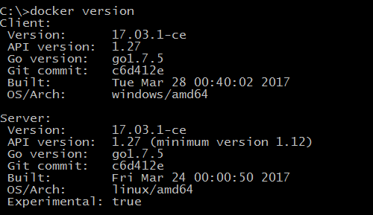
DOCKER VERSION

Slide 14
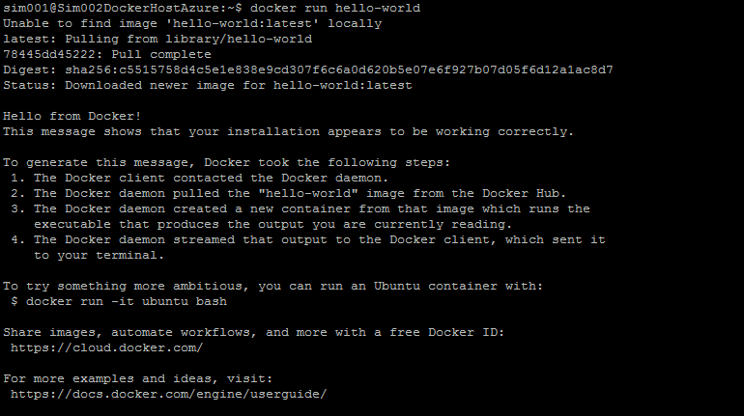
ChecK IF DOCKER is RUNNING

Slide 15
LINUX ALPINE
Stap | Wat | Commando
1 | Ga in browser naar de Docker store | https://store.docker.com/images/alpine
2 | Kopieer commando om de Docker image te downloaden | Copy
3 | Download in Docker CLI met de gekopieerde commando | docker pull alpine
4 | Run de image | docker run –it alpine /bin/sh

Slide 16
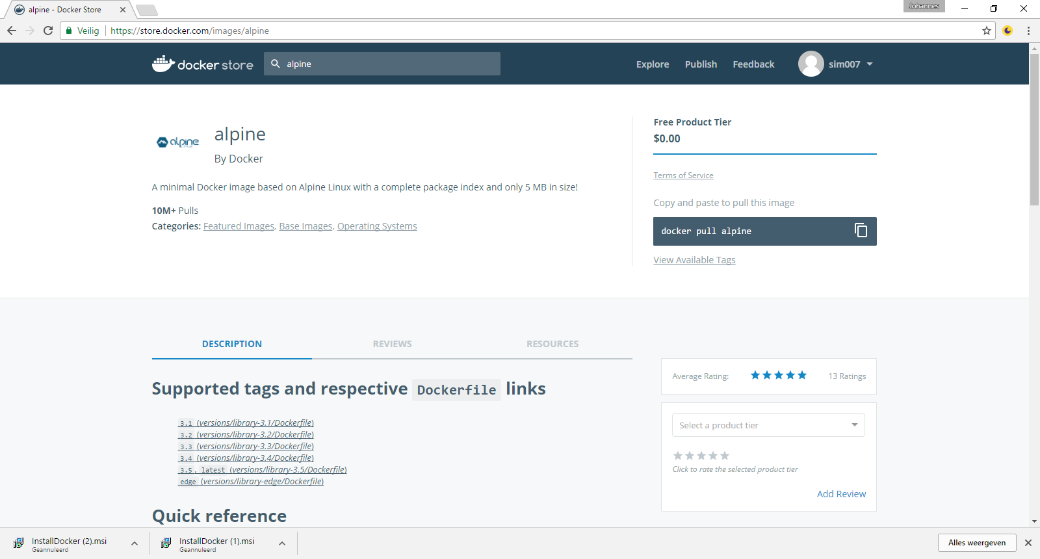
Alpine REPRO

Slide 17
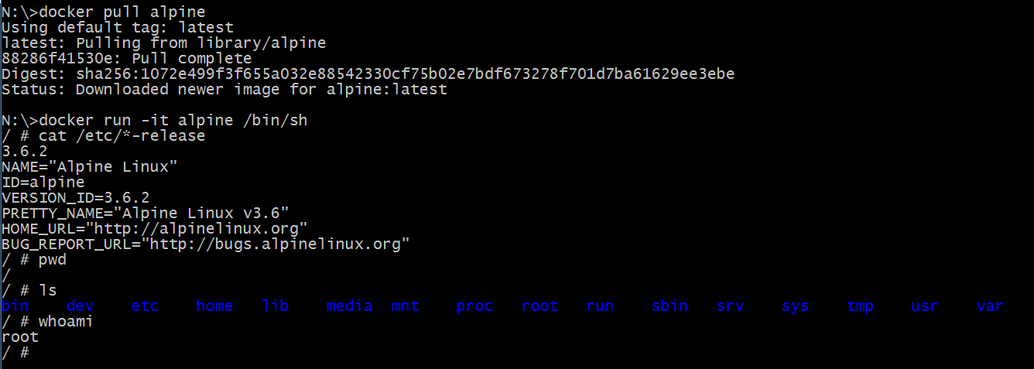
Alpine - DEMO
Notes:
docker pull alpine
docker run -it alpine /bin/sh
Alpine
cat /etc/*-release
Pwd
Ls
Whoami
Ctrl-D
docker ps

Slide 18
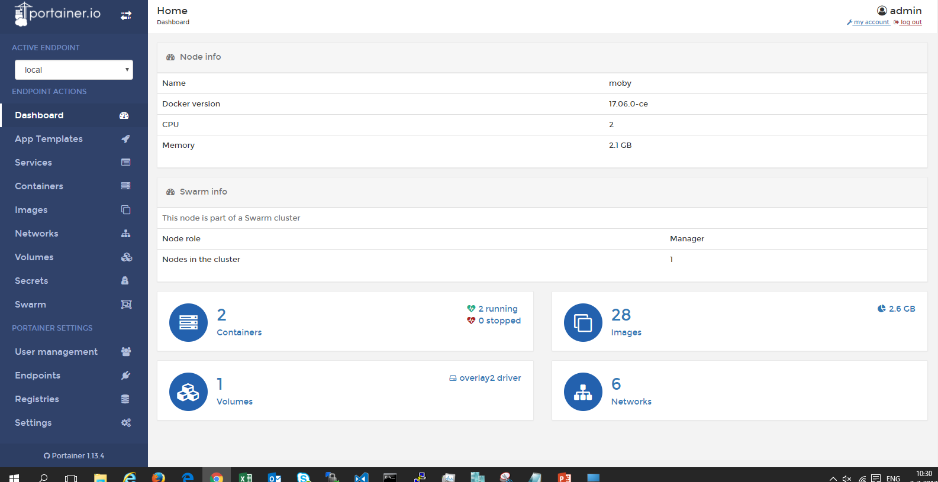
EXAMPLE Docker CONTAINER PoRTainer
docker run -d -p 9000:9000 -v /var/run/docker.sock:/var/run/docker.sock portainer/portainer

Slide 19
DOCKER commands
Docker container run
Docker container ls
Docker container stop

Slide 20
DOCKER CONTAINER RUN

Slide 21
EXAMPLE DOCKER BUILD - DOCKERIZE

Slide 22
DEMO: RuN on AZURE

Slide 23
DOCKER IMAGE PULL

Slide 24
DOCKER IMAGE PUSH

Slide 25
DOCKERIZE

Slide 26
DOCKER BUILD

Slide 27
TOPIC: DOCKER BUILD

Slide 28
TopIC: Version
TAG
Latest

Slide 29
Work FLOW
What is on the laptop?
Static website
Build
Build the image
Ship –Flow
Push to Docker Hub / Docker Store
Pull from Docker Hub / Docker Store
Run
Run on Laptop
Run on Azure host

Slide 30
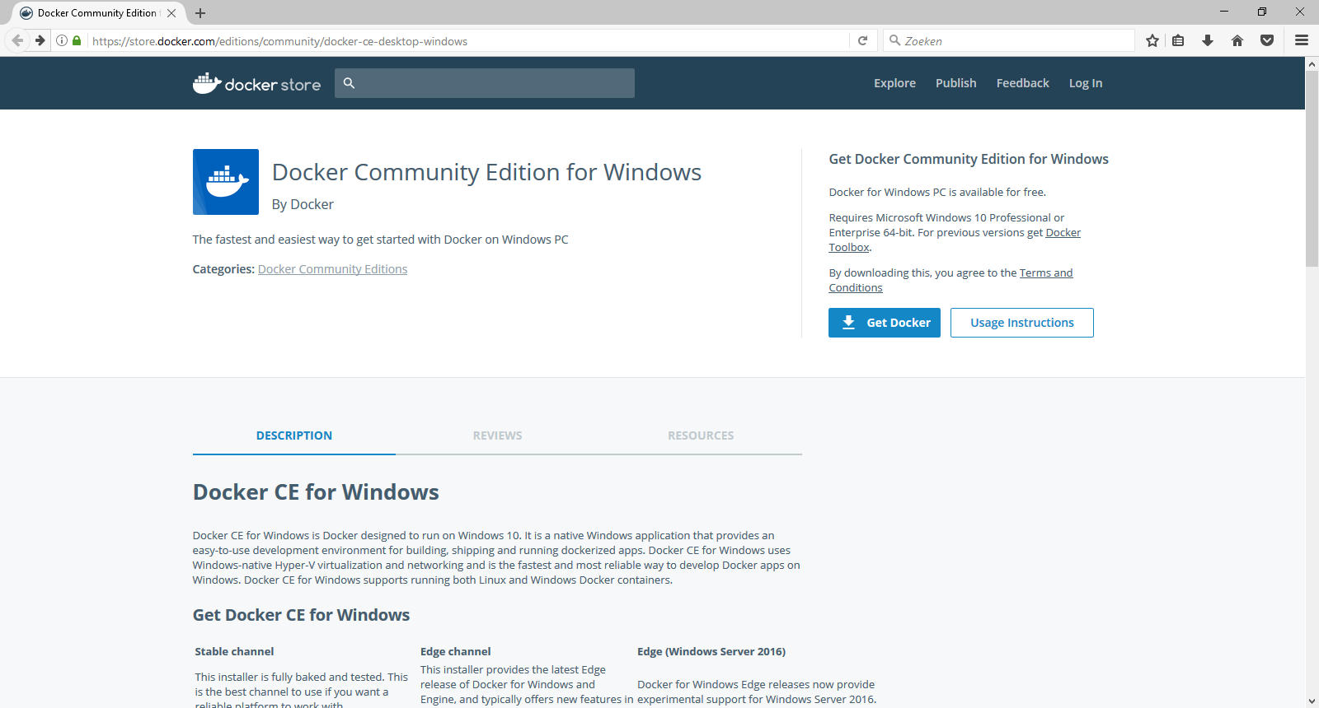
Docker downloaden
https://store.docker.com/editions/community/docker-ce-desktop-windows

Slide 31
Old

Slide 32
Course overview
Day 1
Day 2
Microservices
Docker
Microservices
Docker
1
Introduction
Recap day1 & queries
2
MS 101
MS 102
3
Docker 101
Docker 102
4
Workshop NodeJS example
Workshop .Net example
5
Wrap-up & queries
Wrap-up

Slide 33
User storIES
As PO I want a static website which I can deploy the static website as container and an easy process to change it
As DEV I want to build the website only once and be sure that it is the same software
As OPS I want the same software (in a container) in each environment
As Bus I want a short time to market

Slide 34
On YOUR Laptop

Slide 35
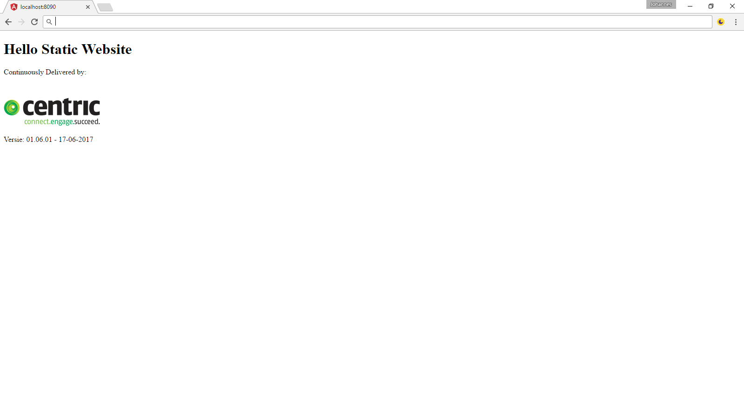
StaTIC website

Slide 36
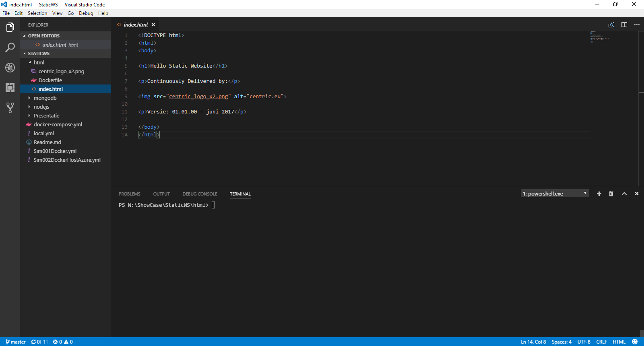
HTML in VS CODE

Slide 37
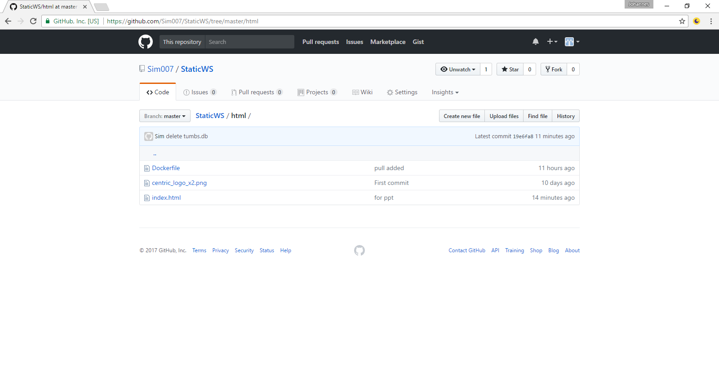
CODE in GIT AND GITHUB
Clone with: https://github.com/Sim007/StaticWS.git

Slide 38
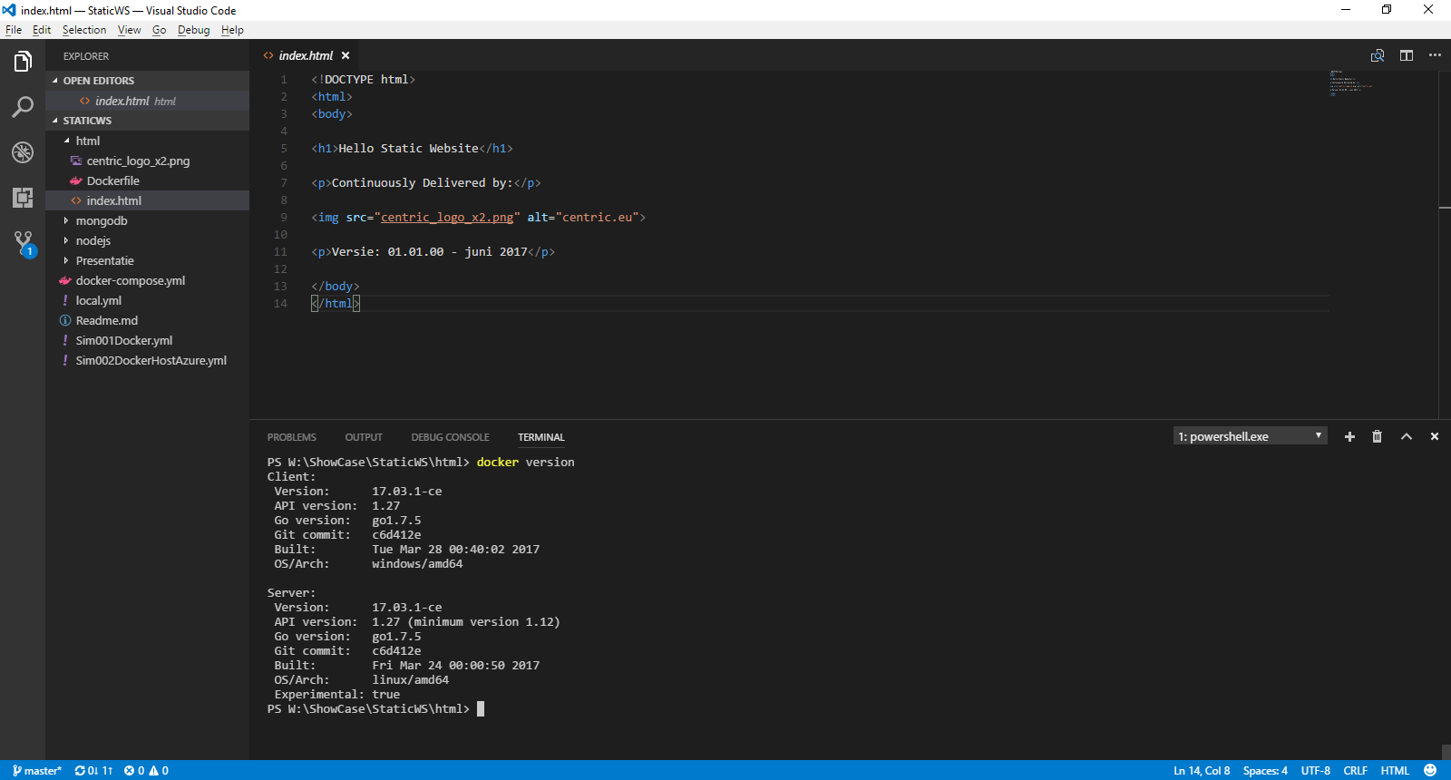
My way of working: Powershell in VS CODE

Slide 39
BUILD: DockerFile
# Showcase
# Static WebSite - no tag
FROM nginx:stable-alpine
MAINTAINER Johannes Sim
ENV REFRESHED_AT 2017-06-05
COPY index.html *.png /usr/share/nginx/html/
# build: docker build -t sim007/staticws .
# run: docker run --name staticws -d -p 8090:80 sim007/staticws
# delete: docker rm -f staticws
# push: docker push sim007/staticws
# in: docker exec -it staticws /bin/sh

Slide 40
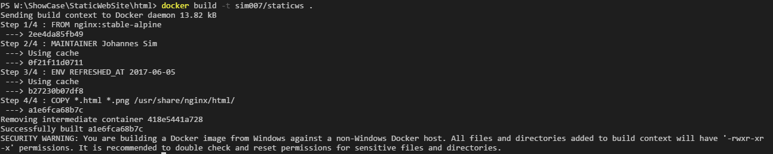
BUILD image
docker build -t sim007/staticws .

Slide 41
RUN: DOCKER CONTAINER
docker run --name staticws -d -p 8090:80 sim007/staticws

Slide 42
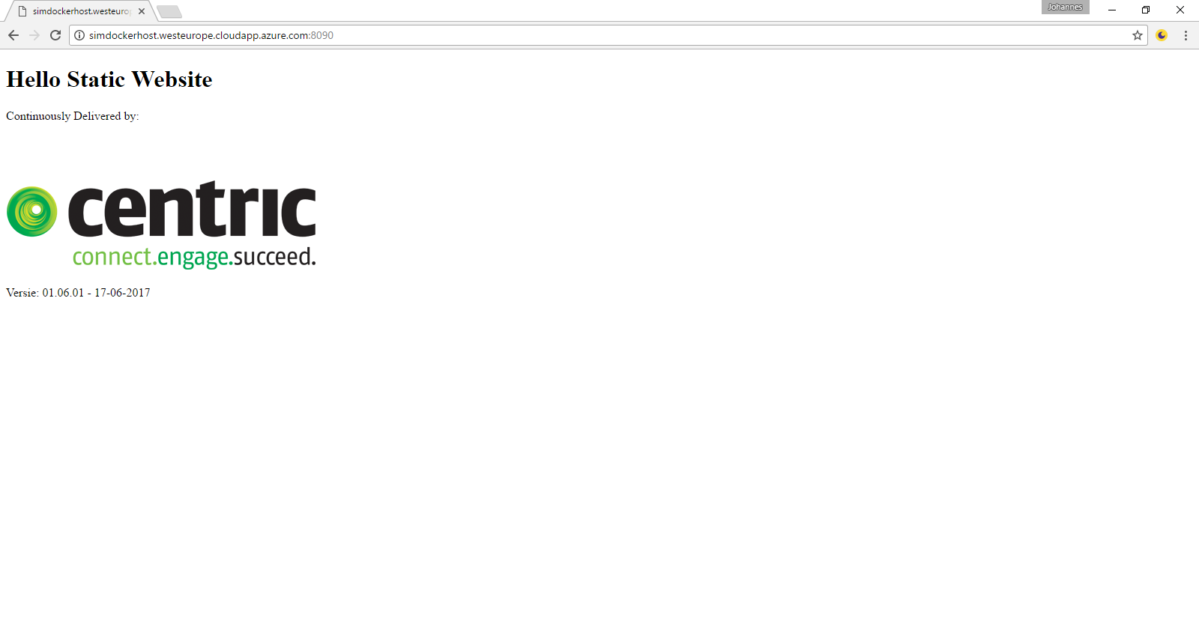
RUN

Slide 43
BUILD SHIP RUN Laptop – Internet – LAPTOP & AZURE VM

Slide 44
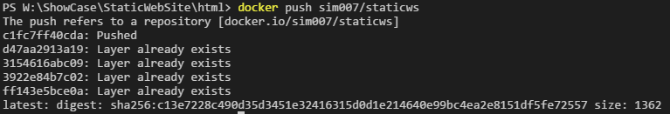
SHIP
docker push sim007/staticws

Slide 45
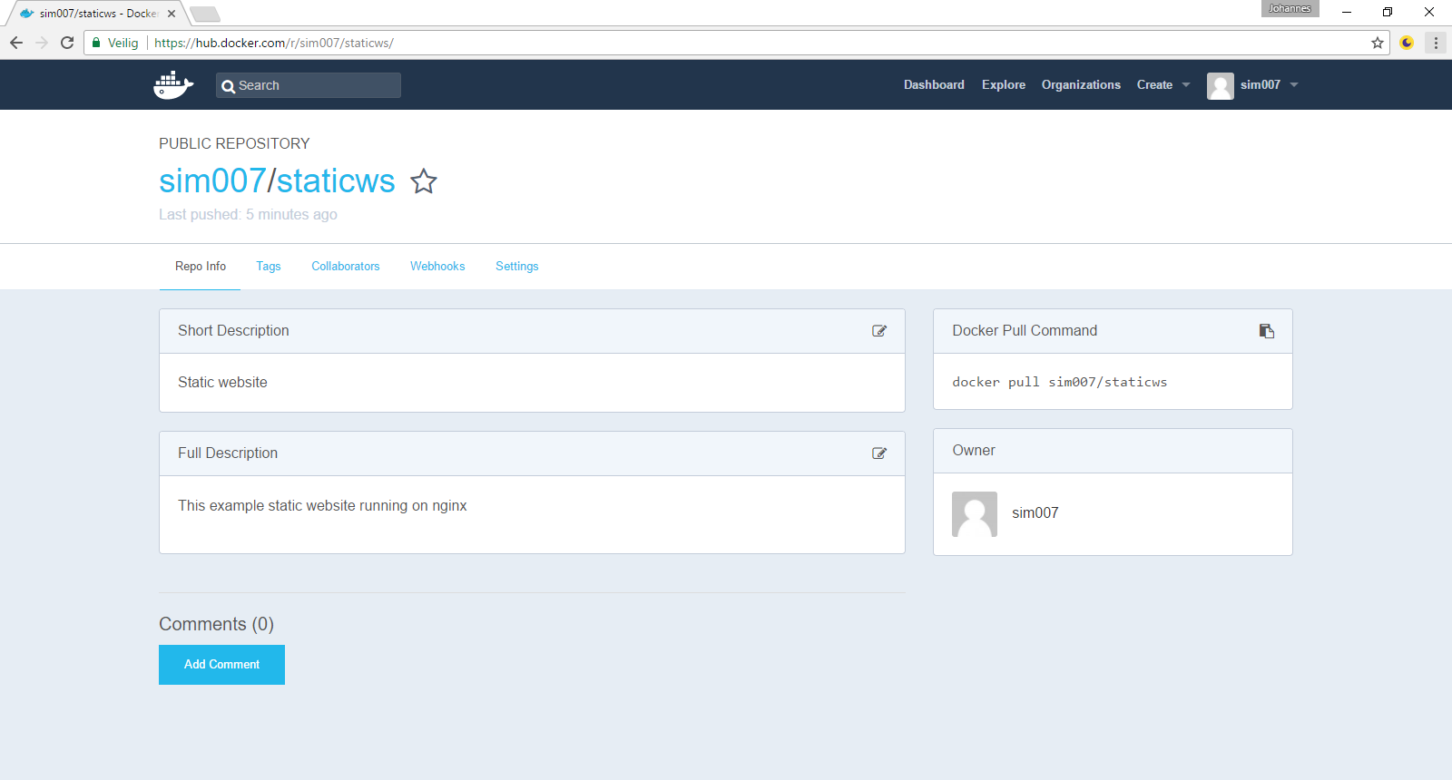
SHIP: Docker HUB

Slide 46
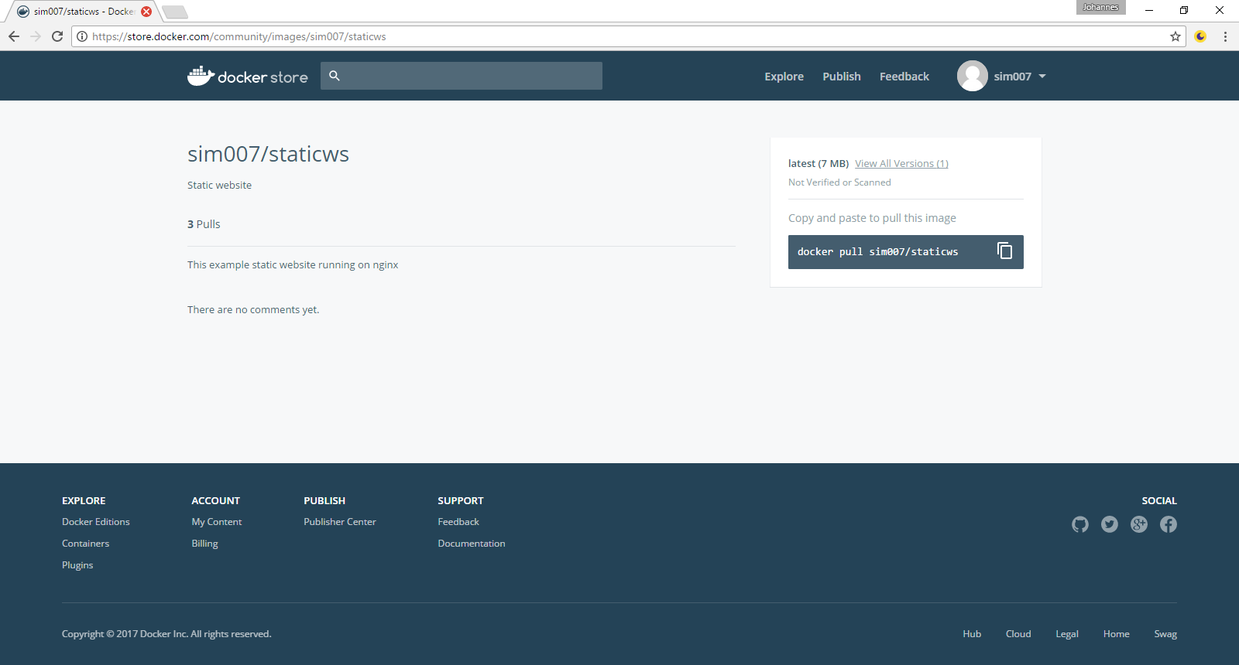
SHIP: Docker STORE

Slide 47
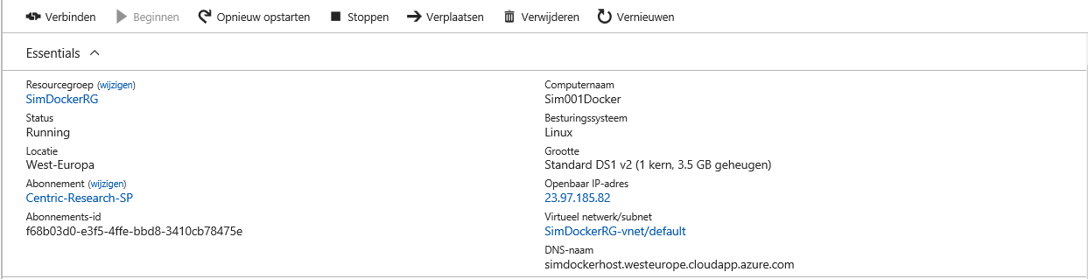
RUN ON VM on AZURE

Slide 48
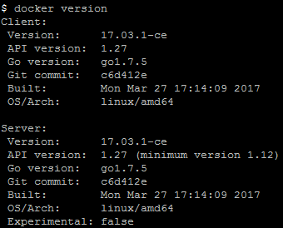

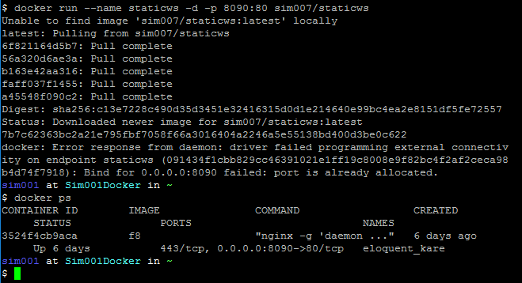
RUN: DOCKER CONTAINER

Slide 49
RUN

Slide 50
Oude Presentatie

Slide 51
Docker DeMO
Docker installeren
Docker CLI interface
“hello world”
.net site
Webserver + test
Jenkins
Benchmark security test
Docker UI / Kitematic

Slide 52
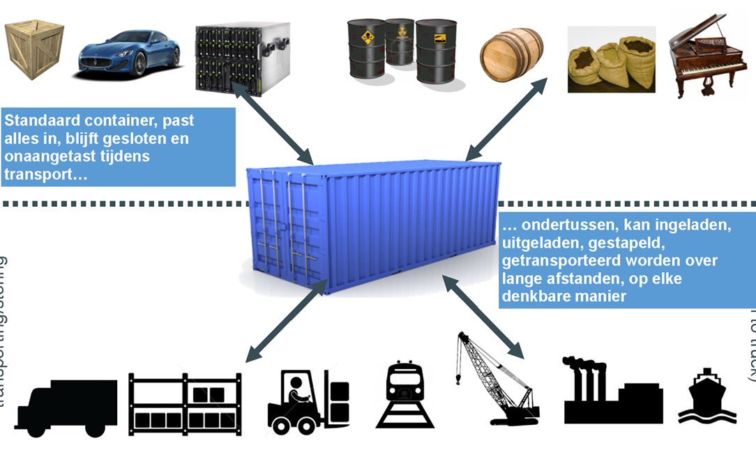
Samenvattend: DOCKER MODEL
DEV “bepaalt” de stack
Dezelfde Container (running image) op iedere omgeving
1 Registry voor images
image = interface (tussen DEV en OPS)
API (Application Program Interface)

Slide 54
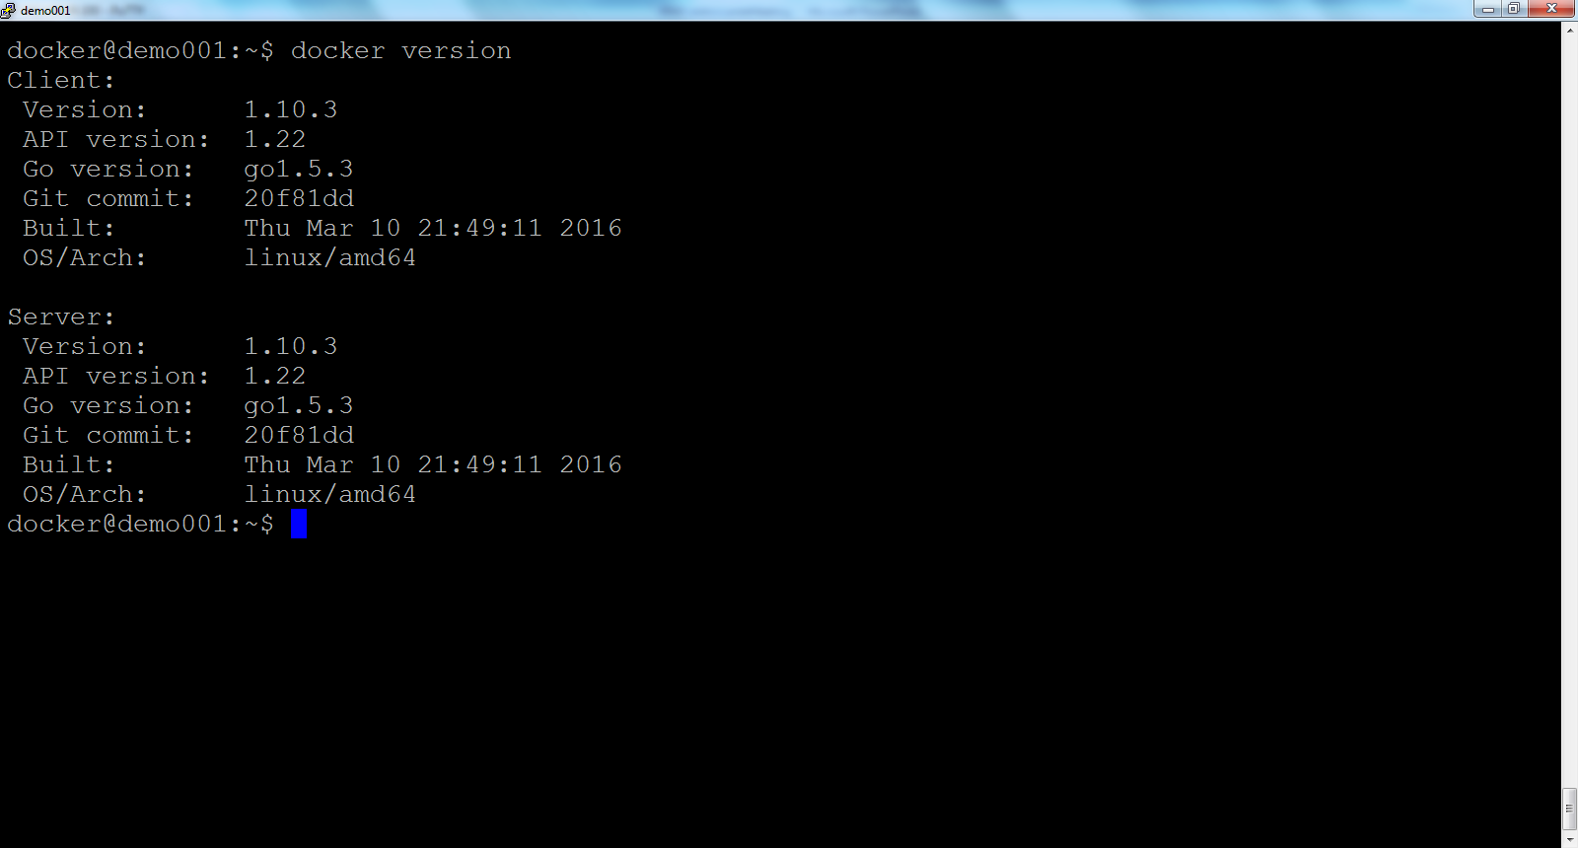
VOORBEELD: Check of Docker werkT

Slide 55
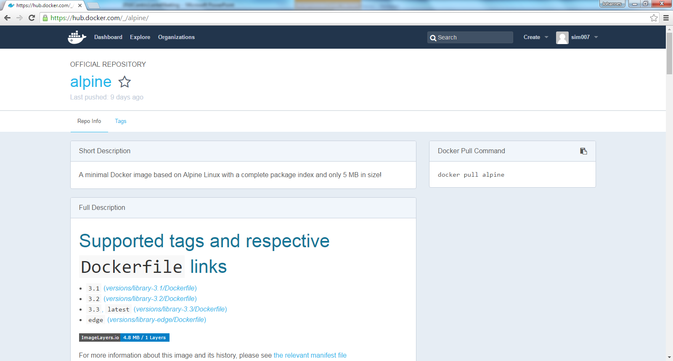
Voorbeeld: Docker HUB ALPINE LINUX

Slide 56
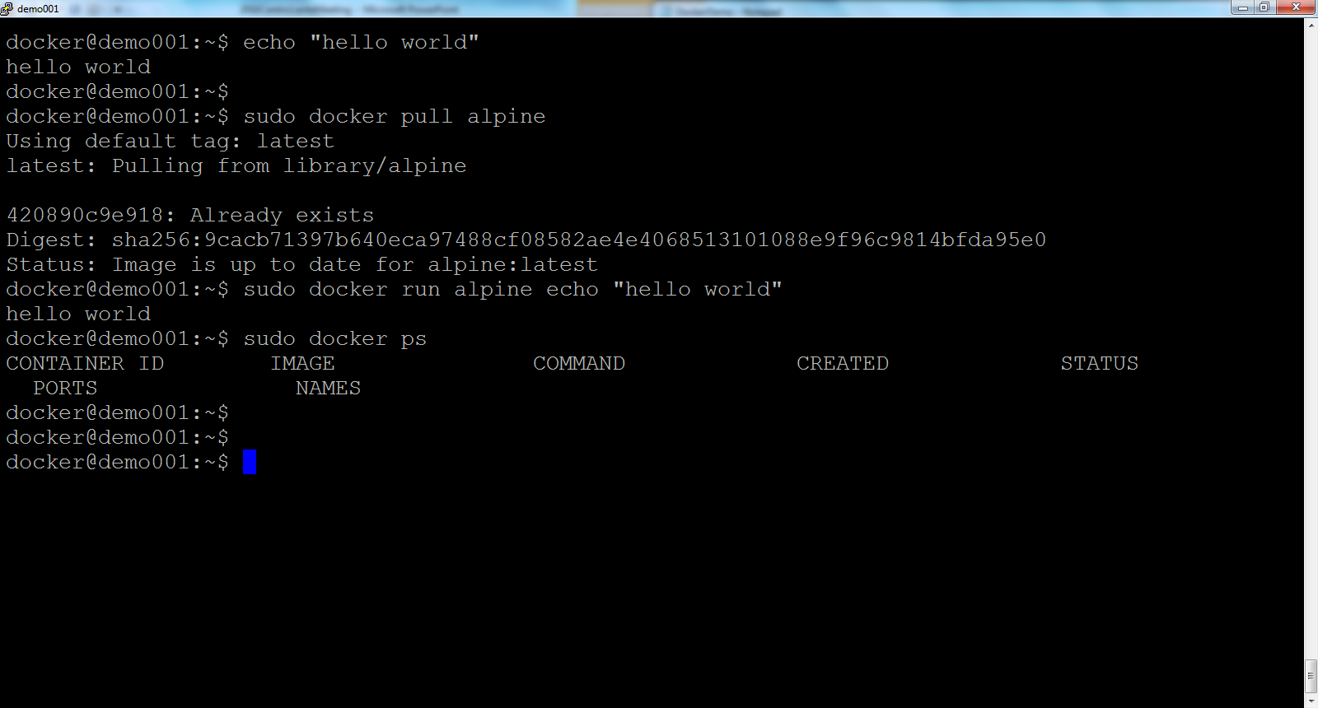
Voorbeeld: Wat is een CoNTainer?

Slide 57
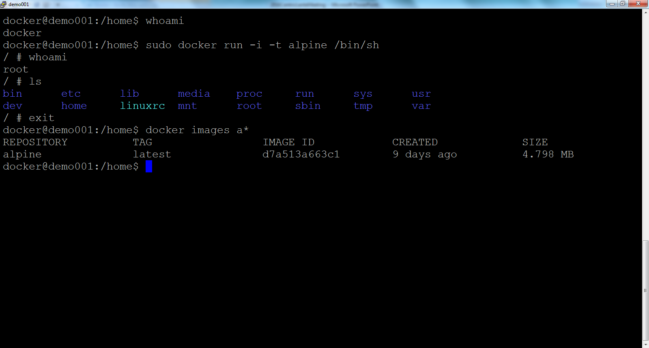
Voorbeeld: Interactieve container

Slide 58
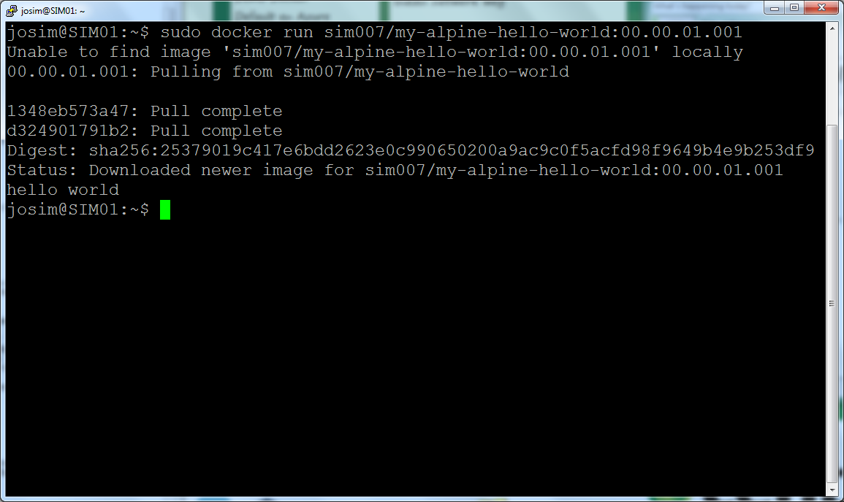
Voorbeeld Server op AZURE

Slide 59
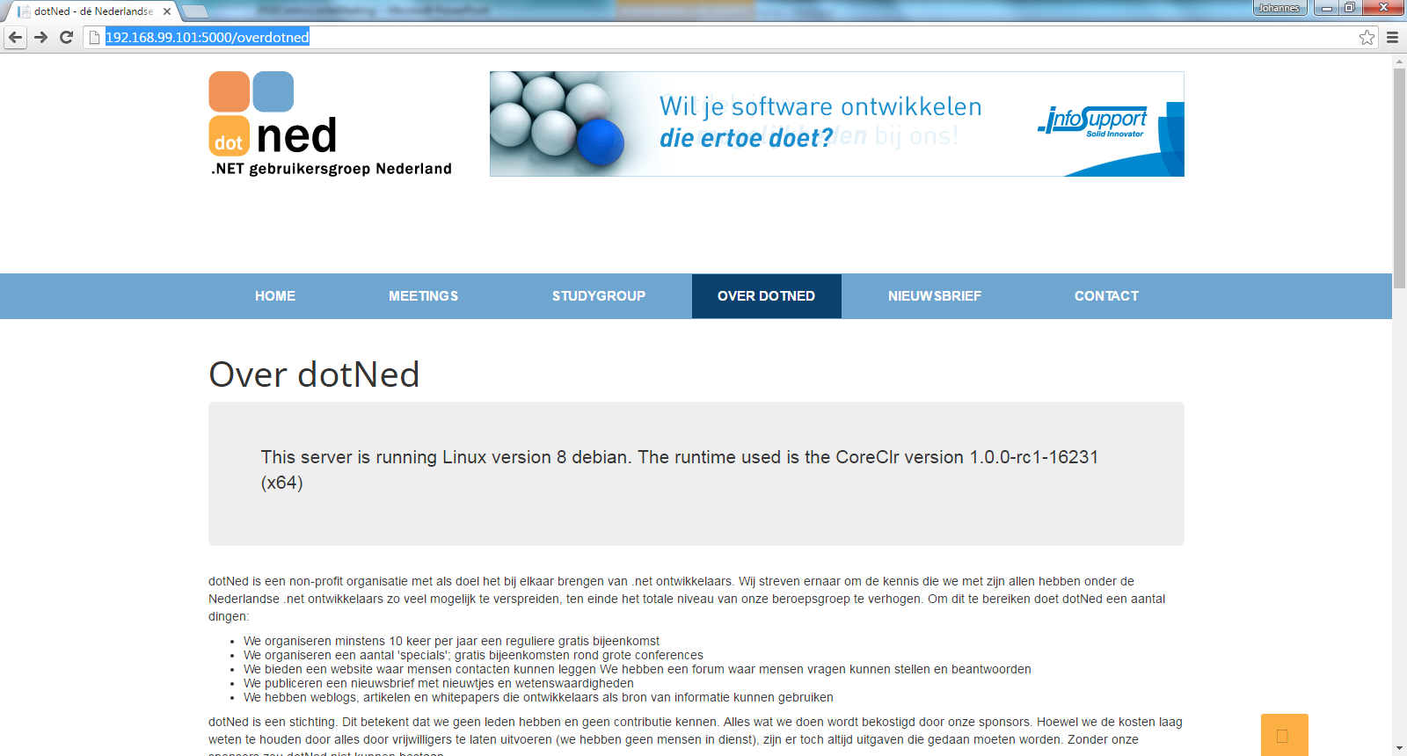
Voorbeeld: .net site in Docker container

Slide 60
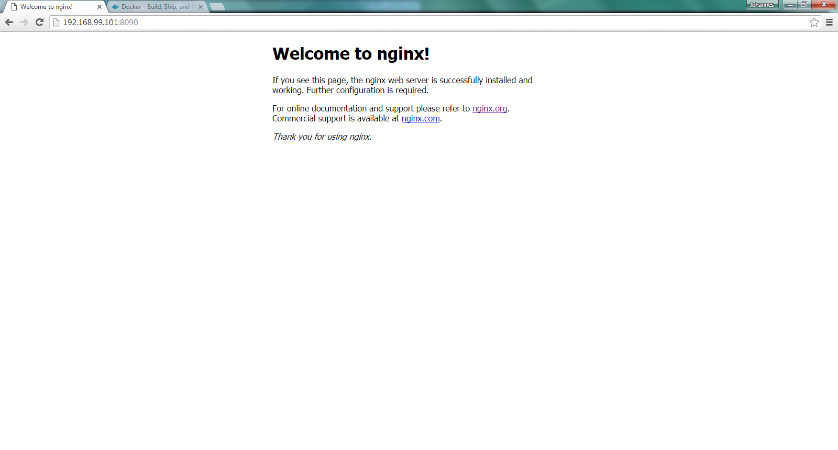
Voorbeeld: NGINX van Docker HUB

Slide 61
CD PIPeLINE
Notes:
It depens uiteraard op de context.
Wat missen jullie?
OTAP
Quality gates

Slide 62
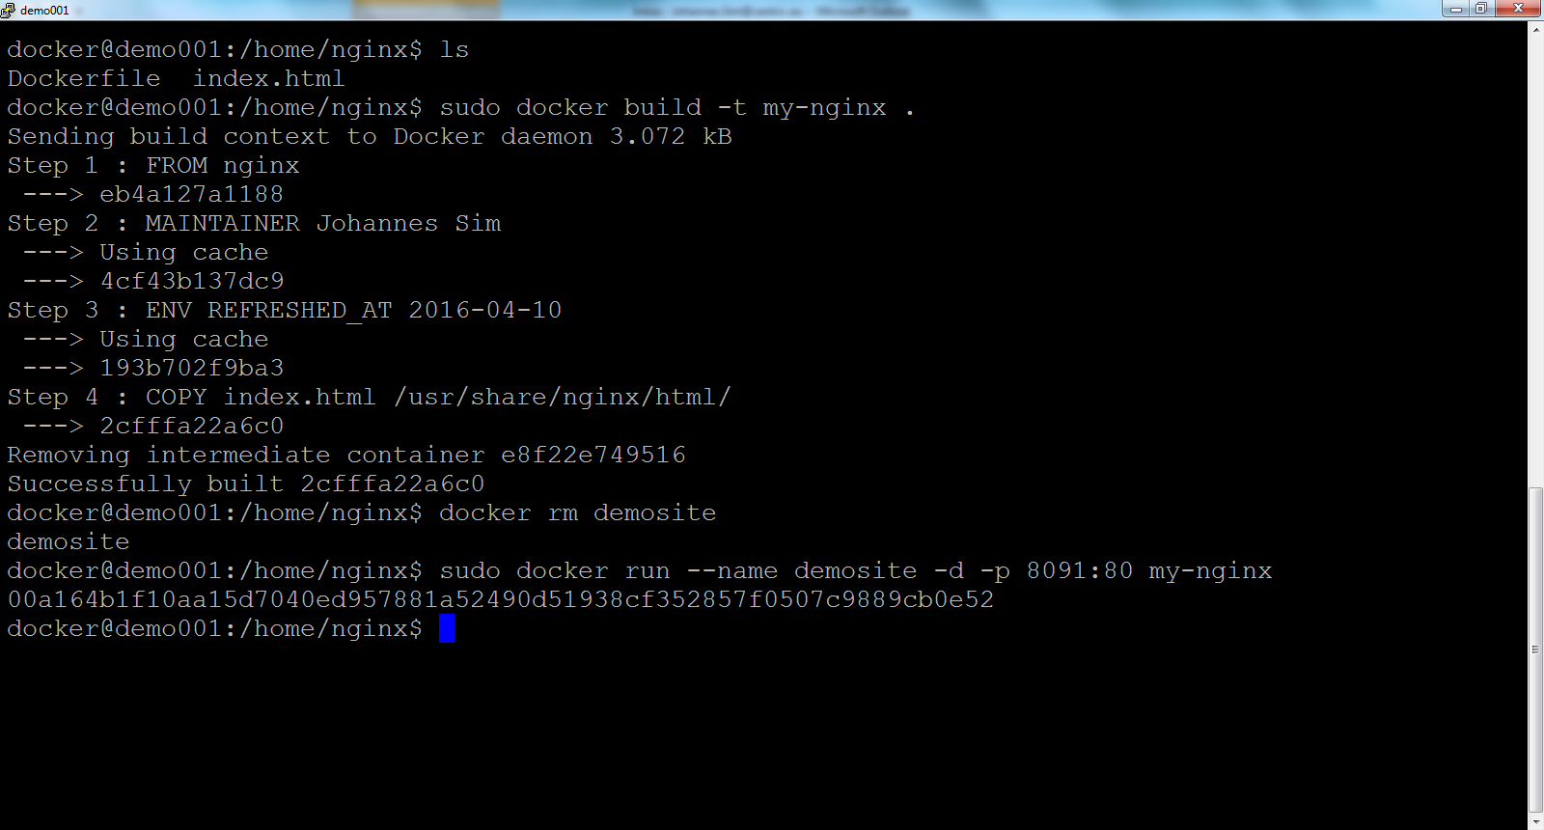
Voorbeeld: Build + RUN

Slide 63
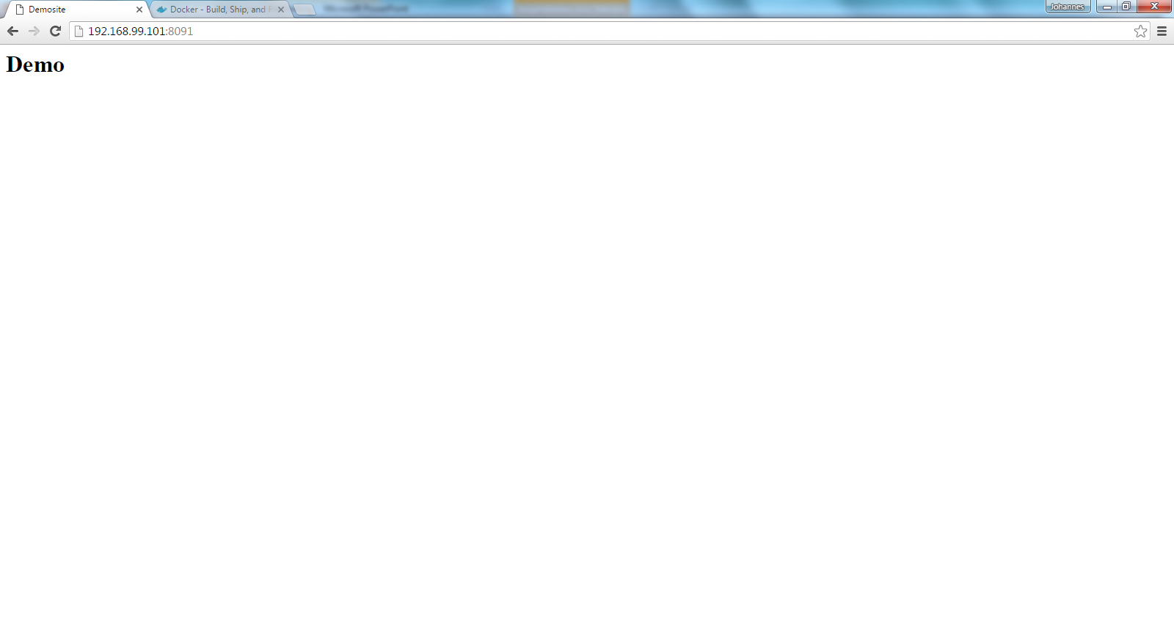
Voorbeeld: WeBSITE in NGINX

Slide 64
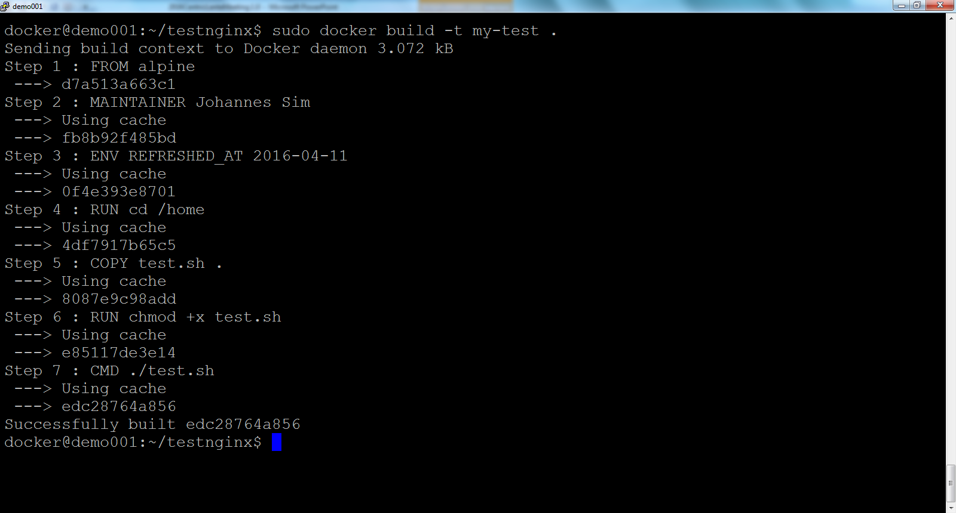
VOORBEELD: build test container

Slide 65
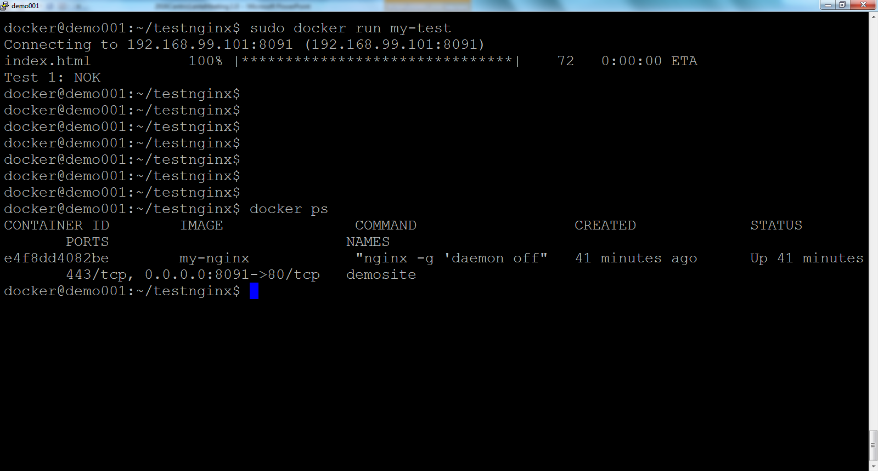
VOORBEELD: RUN TeSTCONTAINER

Slide 66
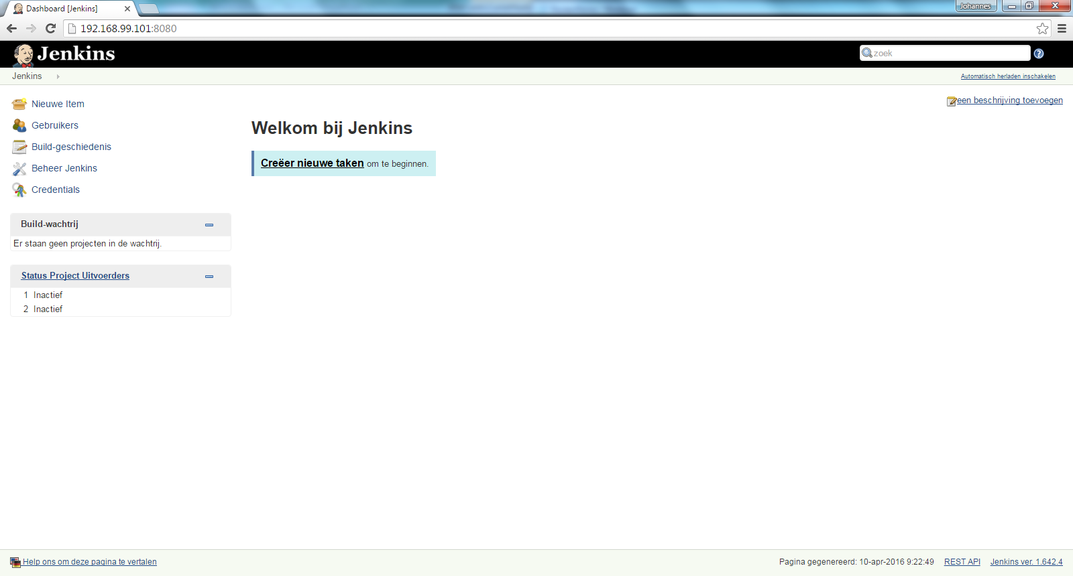
Voorbeeld: Jenkins in Docker container

Slide 67
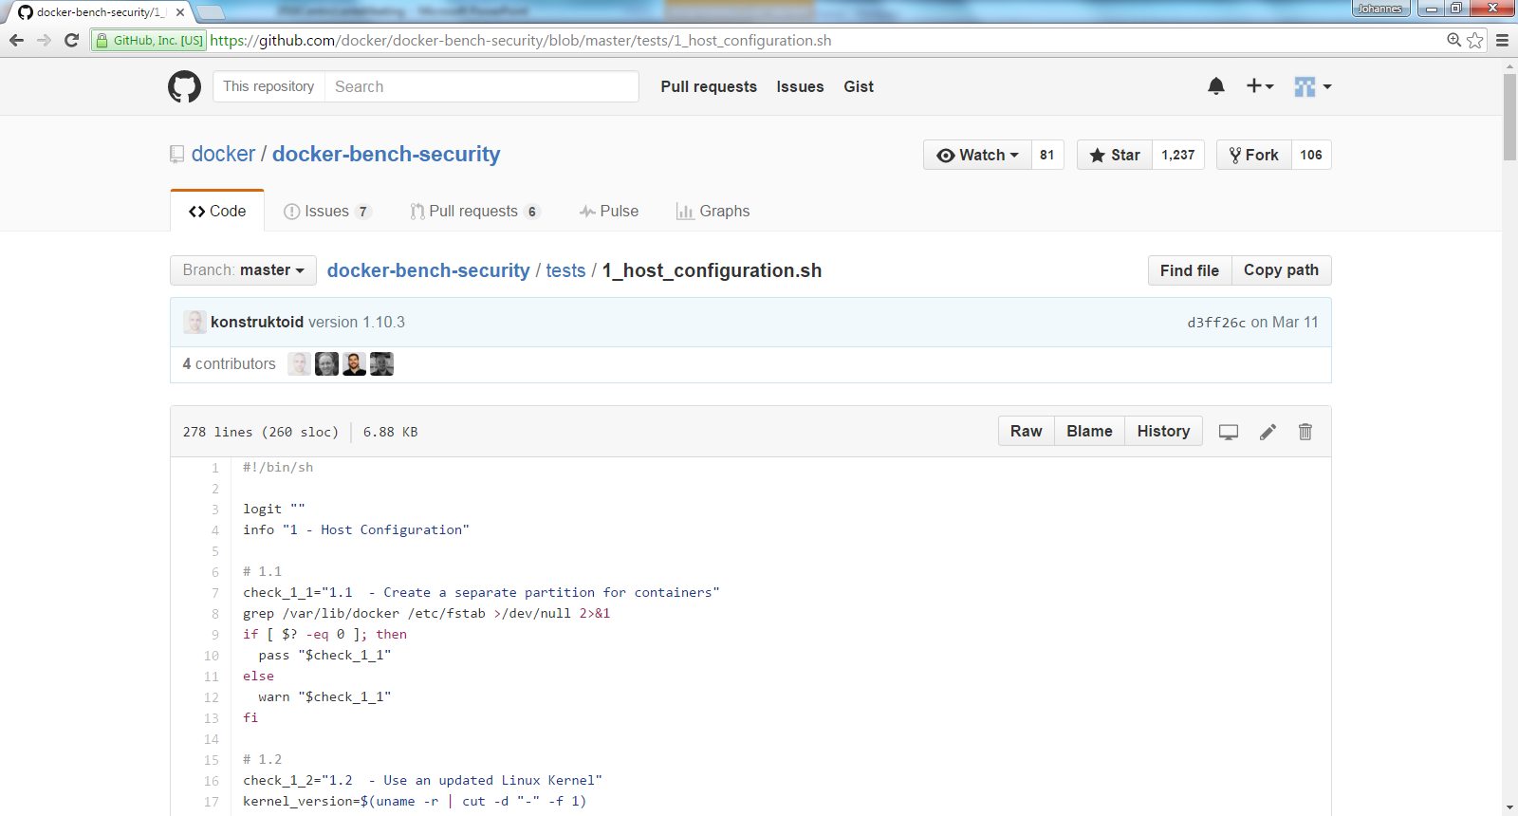
VOORBEELD: Testscript in GIT

Slide 68
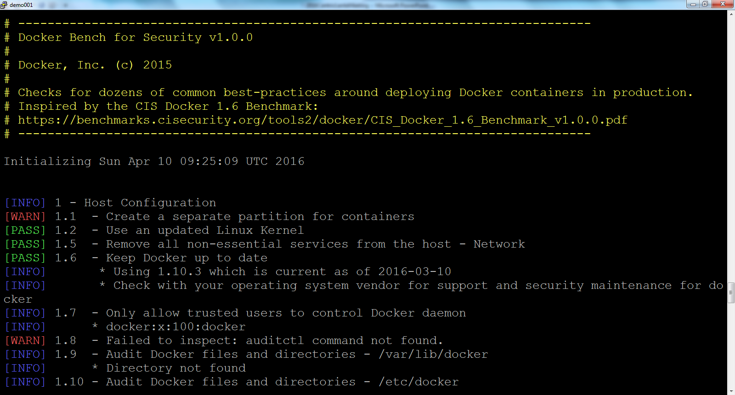
Voorbeeld: Test in Docker container

Slide 69
DIY
Installeer:
https://docs.docker.com/engine/installation/windows/
Resources:
Docker.io
3 gratis cursussen: https://training.docker.com/self-paced-training
Quick start: https://docs.docker.com/engine/quickstart/
Docs and Docs: https://docs.docker.com/
YouTube
Docker Channel: https://www.youtube.com/channel/UC76AVf2JkrwjxNKMuPpscHQ?nohtml5=False
…….

Slide 70
Docker USER stoRIES
Applicatie deployment sterk te vereenvoudigen in CD
Om de test te kunnen uitvoeren
CD ecosysteem
Ontwikkelomgeving
Data in container - tijdreizen

